Slide 1
Making Text for the Web part 5
Barb Ericson
Georgia Institute of Technology
March 2006

Slide 2
Relational Databases
What if you wanted to keep track of the people in your pictures
  And more than one person could be in a picture?
  You might want one table Person with information about each person
  You might want another table Picture with information about each Picture
  And another table to PicturePerson to link the two together
    Which people are in what picture

Slide 3
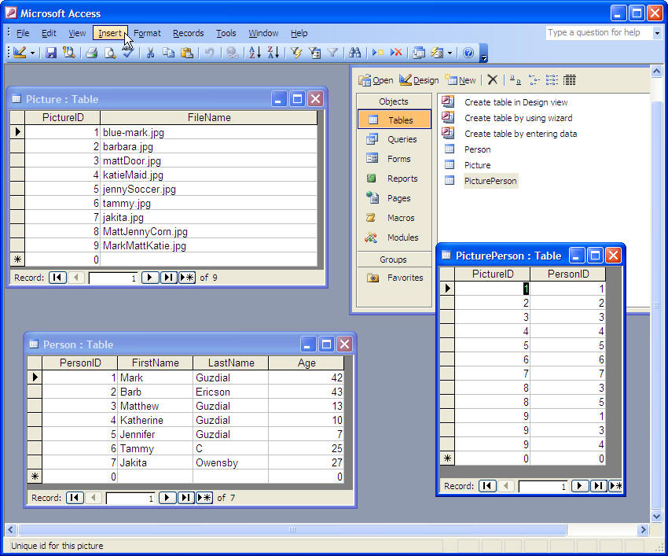
Person Database
In your bookClasses directory
  Is a Microsoft Access database
    Person.mdb

Slide 4
Where is Jennifer Guzdial?
First look up the PersonID for Jennifer Guzdial
  She is number 5
Now look in the PicturePerson table for that PersonID to get the ids for the pictures (PictureID)
  She is in picture 5 and picture 8
Now use the PictureID to find the file name for that picture
  jennySoccer.jpg
  MattJennyCorn.jpg

Slide 5
Getting Data from a Database
Use SQL to get data from the database
  Structured Query Language
  Works with any relational database
Use classes in java.sql
  DriverManager – to manage the driver
  Connection – to connect to the database
  Statement – to send a query to the database
  ResultSet – to hold the results of a query

Slide 6
Loading the Driver
You first have to load the driver class
  Handles working with a particular kind of database
  Use Class.forName(DriverClass);
For an Access Database
  Class.forName(sun.jdbc.odbc.JdbcOdbcDriver);
For a MySQL Database
  Class.forName(com.mysql.jdbc.Driver);

Slide 7
Creating a Connection
Specifies the database to connect to
  And optionally the login and password to use
Examples
  Connection connection = DriverManager.getConnection(url, "login", "password");
  Connection connection = DriverManager.getConnection(url);
Specifying the URL
  For an Access Database
    Use an ODBC to JDBC bridge
    jdbc:odbc:person
  For a MySQL Database
    Use JDBC to MySQL
    jdbc:mysql://localhost:3306/person

Slide 8
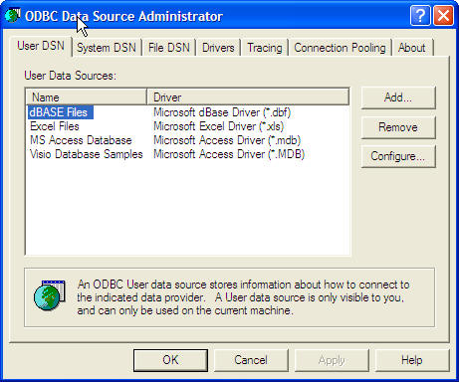
Access Database ODBC Name
To connect to an Access Database
  You will need to assign an ODBC name
  Open the Control Panel and then get to the ODBC Datasource Administrator Window
    In Administrative Tools
  Click on the User DSN Tab
    Click on the Add button

Slide 9
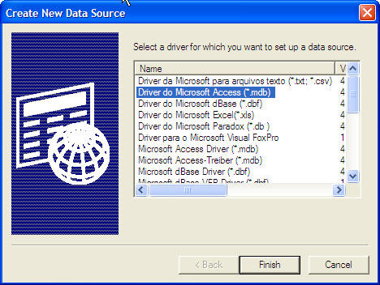
Adding the Data Source Name
Click on
  Diver do Microsoft Access (*.mdb)
Click on Finish

Slide 10
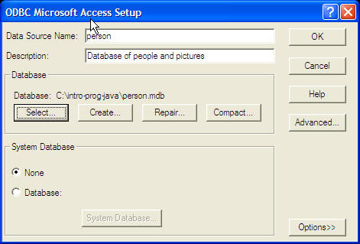
Mapping a DSN to a Database
Add a Data Source Name
  person
Fill in a description
Click on Select and pick the database file
  person.mdb

Slide 11
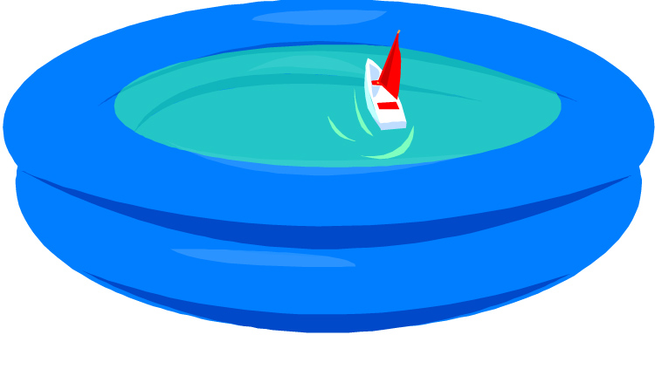
Closing a Connection
There is often a limit on how many connections there can be to a database at a time
  But many programs can be connected at the same time
Most database drivers pool the database connections
  So you want to close the connection after you finish a query
    To release it back to the free pool
    connection.close();
Free pool
Notes:
Closing a connection doesn't actually close it, it only releases it back to the pool of free connections.

Slide 12
DatabaseManager
import java.sql.*;
import java.util.*;
/**
* Class that handles the connection with the database
*/
public class DatabaseManager
{
////////////// fields ////////////////////////////
private String driverName;
private String urlStr;
/**
* Constructor that takes the driver name and url
* @param driver the class that communicates with the
* database
* @param url the url of the database as a string
*/
public DatabaseManager(String driver, String url)
{
this.driverName = driver;
this.urlStr = url;
// try the following
try {
// load the driver class
Class.forName(driver);
} catch (ClassNotFoundException ex) {
SimpleOutput.showError("Can't find the driver class " +
driver + ", check the classpath");
}
}

Slide 13
Testing the Connection
/**
* Method for testing the connection
*/
public void testConnection()
{
// try the following
try {
// open the connection to the database
Connection connection =
DriverManager.getConnection(this.urlStr);
// tell the user the connection was opened
System.out.println("Connection established");
// close the connection
connection.close();
// tell the user the connection was closed
System.out.println("The connection was closed");
} catch (SQLException ex) {
SimpleOutput.showError("Trouble with the " +
"database connection");
ex.printStackTrace();
}
}

Slide 14
Main to Test the Connection
/* main for testing */
public static void main(String[] args)
{
// create the database manager for an Access database
DatabaseManager dbManager =
new DatabaseManager("sun.jdbc.odbc.JdbcOdbcDriver",
"jdbc:odbc:person");
// create the database manager for a MySQL database
// new DatabaseManager("com.mysql.jdbc.Driver",
// "jdbc:mysql://localhost:3306/person");
// test the connection
dbManager.testConnection();
}

Slide 15
Getting Data from the Database
To query the database
  Use a select statement
  Specify the fields to be selected
  Specify the table to select from
  Select fieldList From tableName [Where condition]
Examples
  Select * From Person
    Will return all rows and fields (in order) in the Person table
  Select FirstName, Age From Person
    Will return all rows with first name and then age
  Select * from Person Where Age > 40
    Will return rows where the person age is greater than 40

Slide 16
Using a Statement
Statements are used to send queries to the database
You need to create a statement
  Only one can be open on a connection at a time
  Statement statement = connection.createStatement();
Execute the query
  ResultSet rs = statement.executeQuery(query);
Process the result set
Close the statement
  statement.close();

Slide 17
Processing the ResultSet
The ResultSet is a temporary table of data
  We need to walk through each row of data
  The cursor starts off before the first row
    So you can use while (rs.next())
  Get the data for a column using
    getXXX(int colNum) where XXX is type of data
      Starting with 1 as the first column
      Or
    getXXX(String colName)
      Using the name of the column for colName
  Close the result set
    rs.close();

Slide 18
testQuery Method
/**
* Method to test a query and print the results
* @param query the query to execute
* @param numCols the number of columns in the result
*/
public void testQuery(String query, int numCols)
{
// try the following
try {
// open the connection to the database
Connection connection =
DriverManager.getConnection(this.urlStr);
// create a statement
Statement statement = connection.createStatement();
// execute the query
ResultSet rs = statement.executeQuery(query);
// print out the results
while (rs.next())
{
for (int i = 1; i <= numCols; i++)
{
System.out.print(rs.getString(i) + ", ");
}
System.out.println();
}
// close everything
rs.close();
statement.close();
connection.close();
} catch (SQLException ex) {
SimpleOutput.showError("Trouble with the database " +
urlStr);
ex.printStackTrace();
}

Slide 19
Main for testQuery
/* main for testing */
public static void main(String[] args)
{
// create the database manager for an Access database
DatabaseManager dbManager =
new DatabaseManager("sun.jdbc.odbc.JdbcOdbcDriver",
"jdbc:odbc:person");
// create the database manager for a MySQL database
// new DatabaseManager("com.mysql.jdbc.Driver",
// "jdbc:mysql://localhost:3306/person");
// test a query
dbManager.testQuery("Select FirstName, Age from Person",2);
}

Slide 20
Narrowing the Query
/* main for testing */
public static void main(String[] args)
{
// create the database manager for an Access database
DatabaseManager dbManager =
new DatabaseManager("sun.jdbc.odbc.JdbcOdbcDriver",
"jdbc:odbc:person");
// create the database manager for a MySQL database
// new DatabaseManager("com.mysql.jdbc.Driver",
// "jdbc:mysql://localhost:3306/person");
// test a query
dbManager.testQuery("Select FirstName, Age from Person " +
"Where Age > 40",2);
}

Slide 21
Exercise
Modify the query to get the first name and last name of the people under age 20
Modify the query to get the PictureID of the pictures that have PersonID of 3 in them
Modify the query to get the first names of the people with a last name of Guzdial

Slide 22
Summary
To get data from a Database
  You need to load the driver
  Know how to connect to the database
  Create a connection
  Create a statement
  Use the statement to execute a query and get a result set
    Using the SQL Select statement
  Process the result set
  Close the result set, statement and connection
    Closing the connection puts it back in the free pool of connecitons

